Slide 1
Journey of Walmart
From Sam Walton’s Vision to Global Retail Giant

Slide 2
Early Life of Sam Walton
• Born: March 29, 1918, in Kingfisher, Oklahoma, USA
• Family moved often during the Great Depression
• Education: Bachelor’s degree in Economics, University of Missouri (1940)
• Early Career: Worked at J.C. Penney as a management trainee
• Served in the U.S. Army during World War II

Slide 3
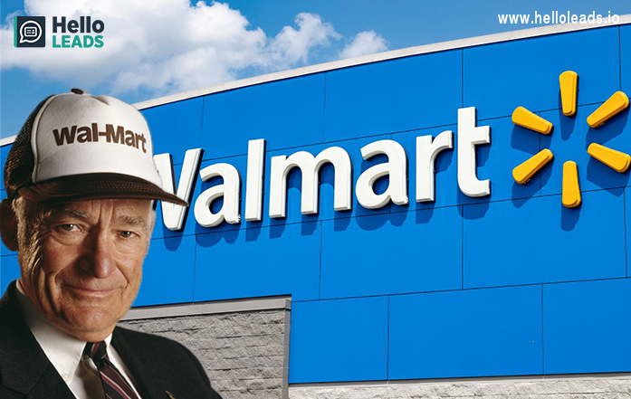

Slide 4
First Steps in Retail
• 1945: Bought a Ben Franklin variety store in Newport, Arkansas
• Applied discount pricing strategies and focus on volume sales
• Introduced innovations like self-service model and lower profit margins
• Gained experience that shaped Walmart’s future

Slide 5
Founding of Walmart
• 1962: Opened first Walmart store in Rogers, Arkansas
• Idea: Provide low prices to help people save money and live better
• Concept: Rural locations, discount pricing, customer-first approach
• Motto: 'Always Low Prices'

Slide 6


Slide 7
Growth of Walmart
• 1960s–70s: Expanded rapidly in Arkansas and nearby states
• 1970: Walmart Inc. went public
• 1980s: Walmart became one of the largest U.S. retailers
• Introduced distribution centers and advanced logistics
• Technology-driven supply chain management

Slide 8
Walmart Supercenters
• First Supercenter opened in 1988
• Concept: One-stop shopping with groceries, clothing, electronics, and more
• Combination of discount store and supermarket
• Became Walmart’s most successful format
• Attracted millions of customers worldwide

Slide 9
Sam’s Club
• Established in 1983
• Membership-only warehouse club
• Offered bulk products at discounted prices
• Targeted small businesses and families
• Inspired India’s Best Price stores

Slide 10
Walmart in the Global Market
• 1990s: Expanded internationally (Mexico, Canada, China, UK)
• Adapted to local markets with different formats
• Faced challenges in some countries (e.g., Germany, South Korea)
• Successful presence in Latin America and Asia
• Became the world’s largest retailer

Slide 11
Walmart in India
• 2007: Entered India through joint venture with Bharti Enterprises
• Opened 'Best Price' wholesale cash-and-carry stores
• Focused on supplying retailers, not direct consumers (due to FDI rules)
• 2018: Acquired majority stake in Flipkart, India’s leading e-commerce platform
• Strategy: Online + wholesale presence in India

Slide 12
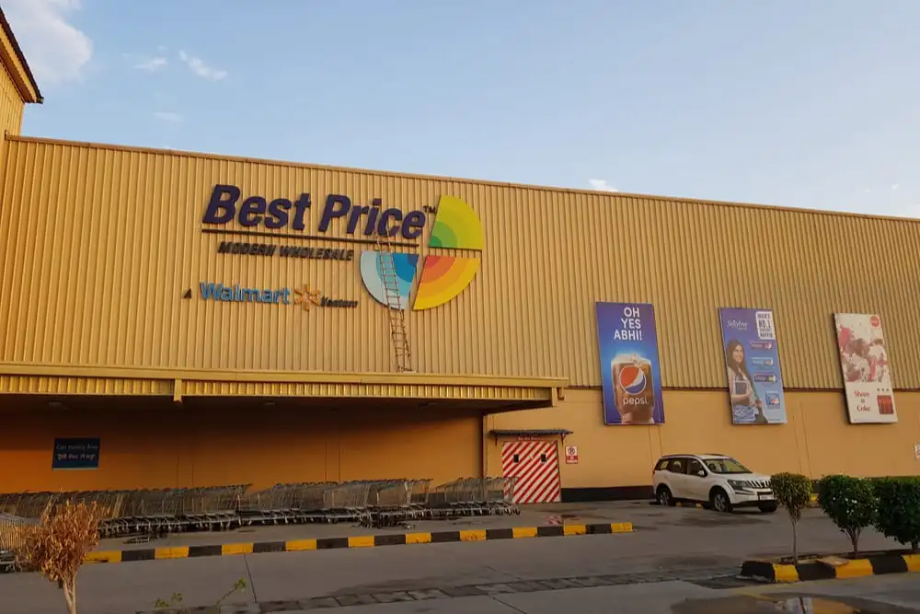

Slide 13
Legacy of Sam Walton
• Known for humility, simplicity, and focus on customer satisfaction
• Believed in teamwork, low prices, and innovation
• Walmart today employs millions of people worldwide
• Continues mission: Save money, live better
• Sam Walton remains a legendary figure in retail history

